Slide 1

Network Layer: IP Addressing
Lecture 6 | CSE421 – Computer Networks
Department of Computer Science and Engineering School of Data & Science

Slide 2
Objectives
Anatomy of IPv4 Address
Subnet/Prefix Mask
Types of Address
Network
Host
Broadcast
Specific Address
Unicast
Multicast
Broadcast
Classful IP Addressing

Slide 3
Anatomy of IPv4

Slide 4
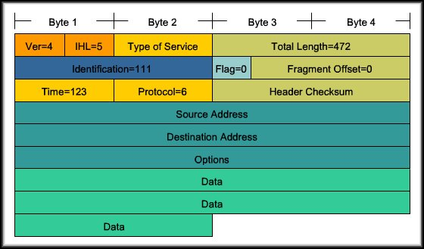
Anatomy of an IPv4 Address
Each device on a network must be uniquely identified at the Network layer.
For IPv4, a 32 bit source and destination address is contained in each packet.

Slide 5
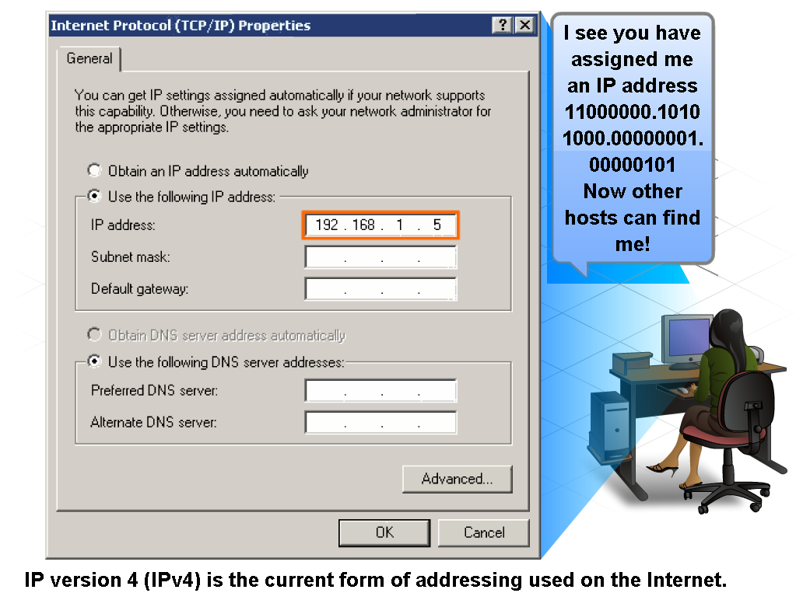
IPv4 Addressing Structure

Slide 6
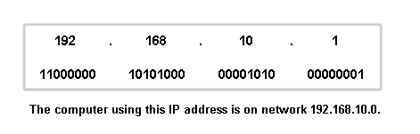
Anatomy of an IPv4 Address
Dotted decimals
Network part
Host part
32 bits
Divided into 4 Octets

Slide 7
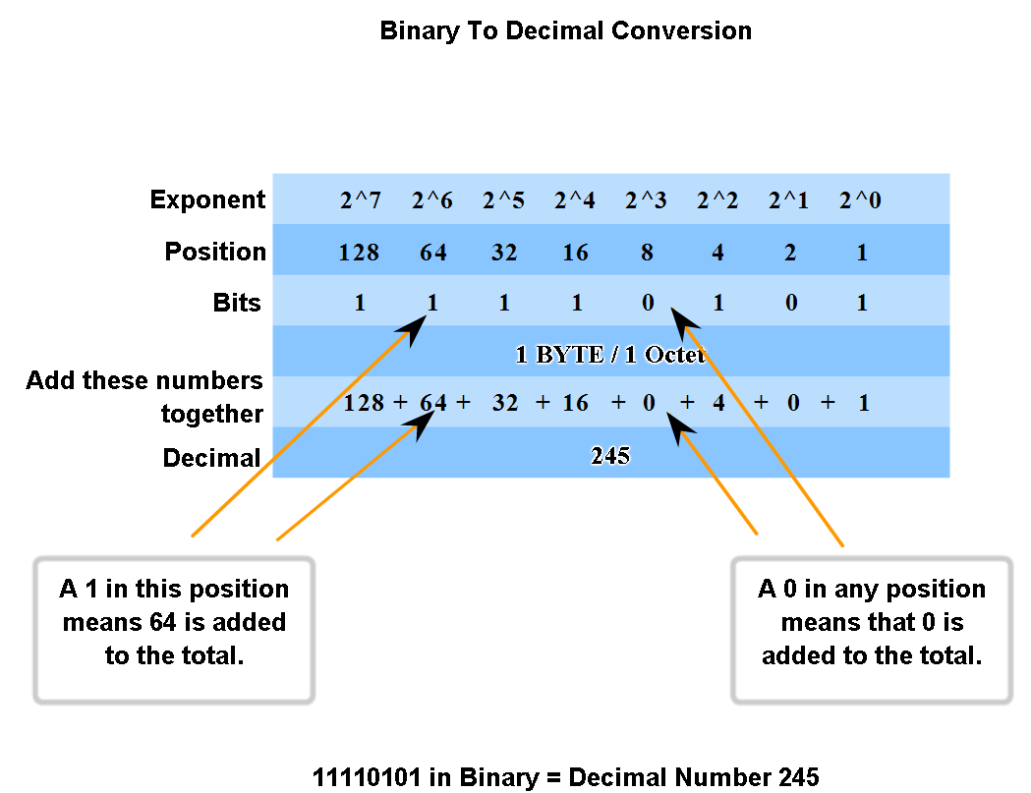
Binary to decimal and Vice Versa

Slide 8
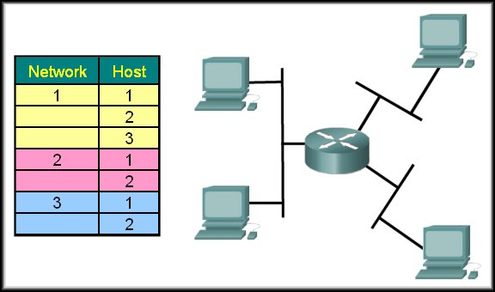
Networks and Hosts
To identify a path or "route" through a network, the address must be composed of two parts:
Network portion
Host portion
1.2
2.2
1.1
2.1
1.3
3.1
3.2

Slide 9
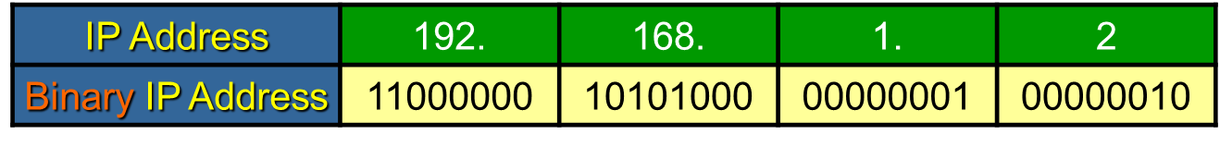
Network Portion
Network Portion:
Some portion of the high-order bits
A network can be defined as a group of hosts that have identical bit patterns in the network address portion of their addresses.
192.168.1.2 | 11000000 | 10101000 | 00000001 | 00000010
192.168.1.67 | 11000000 | 10101000 | 00000001 | 01000011
192.168.1.204 | 11000000 | 10101000 | 00000001 | 11001100

Slide 10
Network Portion
Host Portion:
A variable number of least significant bits that are called the host portion of the address.
The number of bits used in this host portion determines the number of hosts that we can have within the network.
192.168.1.2 | 11000000 | 10101000 | 00000001 | 00000010
192.168.1.67 | 11000000 | 10101000 | 00000001 | 01000011
192.168.1.204 | 11000000 | 10101000 | 00000001 | 11001100

Slide 11
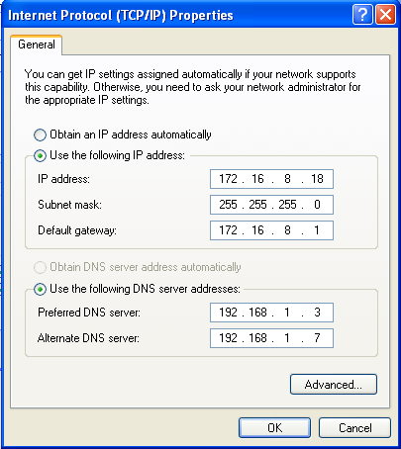
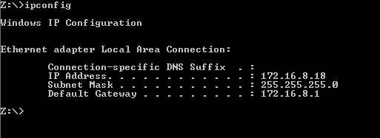
Prefix Mask
How do we or devices identify the network part or the host part?
Answer: Using the “Prefix Mask”.
192.168.10.2/24
Means that the first 24 bits are the network portion.
The last 8 bits are the host portion.
Subnet Mask; the other form of “Prefix Mask”.
Prefix length of /24 means a subnet mask of 255.255.255.0

Slide 12
Subnet Mask
The Prefix Mask and the Subnet Mask are different ways of representing the same information.
Examples:
Prefix Mask of /24 or a subnet mask of 255.255.255.0
Prefix Mask of /16 or a subnet mask of 255.255.0.0
Prefix Mask of /8 or a subnet mask of 255.0.0.0
Conversion:
Subnet mask has the same format as an IP address. Hence, it has 32 bits divided into 8 bits (octets)
Prefix mask of /24 means, the first (MSB) 24 bits of subnet mask would be 1
Binary: 11111111.11111111.11111111.00000000
Decimal: 255 . 255 . 255 . 0

Slide 13
Exercise
What’s the subnet mask of the following?
IP Address: 10.24.36.2 / 4
IP Address: 10.24.36.2 / 12
IP Address: 10.24.36.2 / 16
IP Address: 10.24.36.2 / 23
What’s the prefix mask of the following?
IP Address: 10.24.36.2; Subnet Mask: 255.255.224.0
IP Address: 10.24.36.2; Subnet Mask: 255.255.255.192
IP Address: 10.24.36.2; Subnet Mask: 255.255.255.252
IP Address: 10.24.36.2; Subnet Mask: 255.254.0.0
IP Address: 10.24.36.2; Subnet Mask: 255.255.240.0

Slide 14
ANDing the Binaries
Inside data network devices, digital logic is applied for their interpretation of the addresses.
AND is used in determining the network address.
0 AND 0 = 0
1 AND 0 = 0
1 AND 1 = 1
0 AND 1 = 0
 | Decimal | Binary
IP Address | 135.15.2.1 | 10000111 00001111 00000010 00000001
Subnet Mask | 255.255.0.0 | 11111111 11111111 00000000 00000000
Network Address | 135.15.0.0 | 10000111 00001111 00000000 00000000

Slide 15
But Why AND?
Routers use the ANDing process to determine the route a packet will take.
The network number of the destination address is used to find the network in the routing table.
The router then determines the best path for the frame.

Slide 16
Types of Addresses

Slide 17
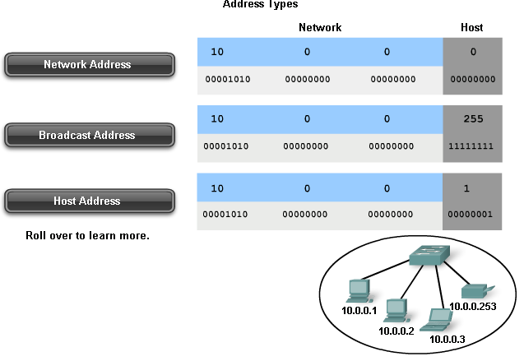
Types of address
Every network has
Network Address – The first IP in the range
Broadcast Address – The last IP in the range
Host Addresses – Everything in between

Slide 18
The Addresses
Network Address
All hosts in the network will have the same network bits.
Cannot be assigned to a device.
Each host bit in this address will be 0.
Broadcast Address
Cannot be assigned to a device.
Each host bit in this address will be 1.
Host Address
The unique address assigned to each device on the network.
For a network of 192.168.10.0/24
Addresses 192.168.10.1 through 192.168.10.254 are all host addresses

Slide 19
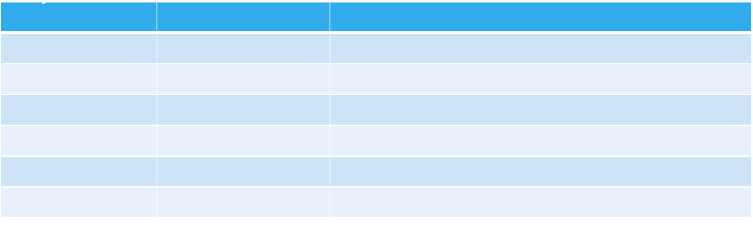
The Addresses at a Glance
Say, you have a random IP address 192.168.10.193/24

Slide 20
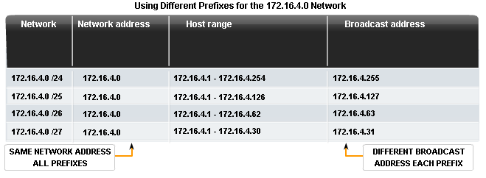
Network Prefix
The network prefix is not always /24.

Slide 21
Special Addresses

Slide 22
Special Addresses
Unicast
A message addressed to one host
Broadcast
A message addressed to all hosts on a network.
Uses network’s broadcast address or 255.255.255.255 locally
Multicast
A message addressed to a group of hosts.
Uses an IP address starting with 224 - 239

Slide 23
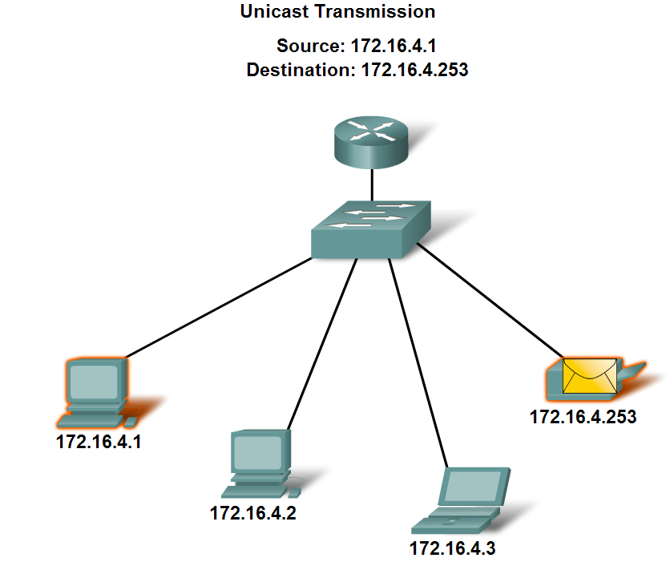
Unicast

Slide 24
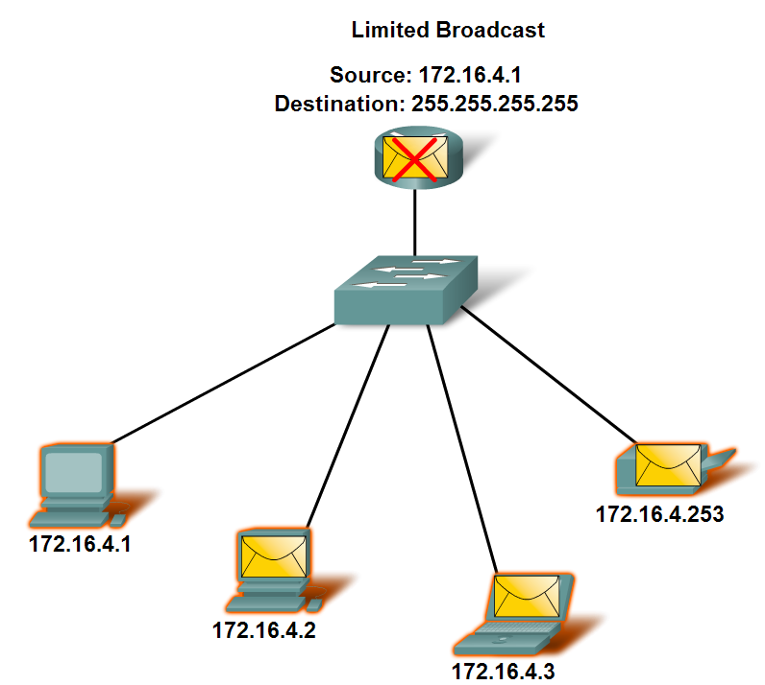
Broadcast Address
Limited Broadcast
Directed Broadcast
For a host outside of the network to communicate with the hosts within the 172.16.4.0 /24 network, the destination address of the packet would be 172.16.4.255.

Slide 25
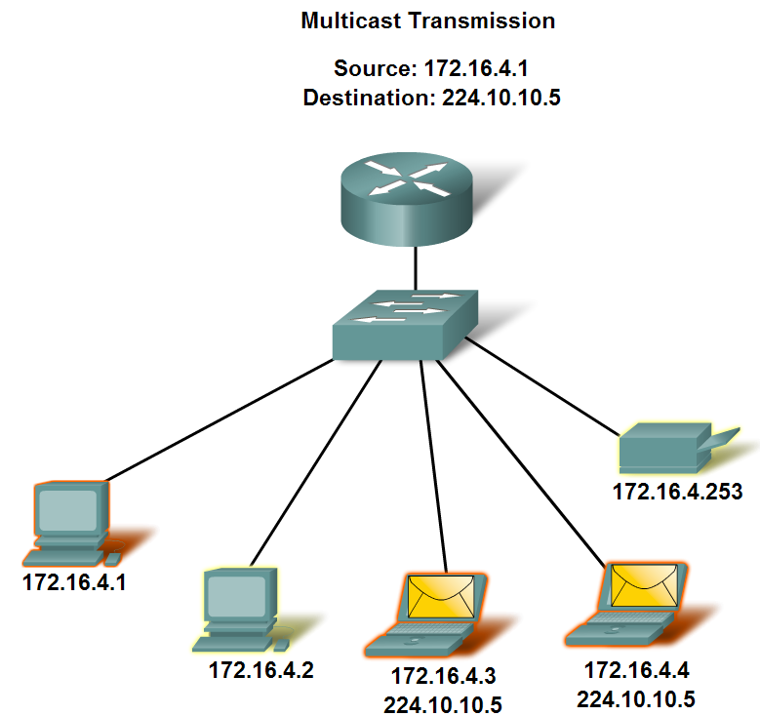
Multicast
Examples of Multicast Application
Video and audio broadcasts
Routing information exchange by routing protocols
Distribution of software
News feeds

Slide 26
Anatomy of IPv6

Slide 27
IPv6
Initial motivation:
32-bit address space soon to be completely allocated.
Additional motivation:
Simpler header format helps speed processing/forwarding
header changes to facilitate QoS

Slide 28
Reasons for using IPv6
Address Availability:
IPv4: 4 octets - 32 bits
2^32 or 4,294,467,295 IP Addresses.
IPv6: 16 octets - 128 bits
3.4 x 10^38 or
340,282,366,920,938,463,463,374,607,431,768,211,456
(340 undecillion) IP Addresses.
Every atom of every person on Earth could be assigned 7 unique addresses with some to spare (assuming 7 × 10²⁷ atoms per human x 6.5 Billion).

Slide 29


IPv6 Address
128 bits
given below is a 128 bit IPv6 address represented in binary format and divided into eight 16-bits blocks
Each block is then converted into Hexadecimal and separated by ‘:’ symbol
Called string notation

Slide 30
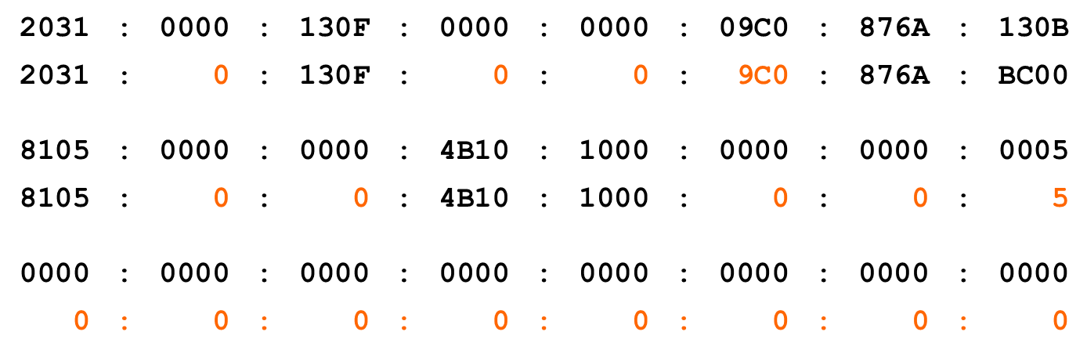
IPv6 Addressing
IPv6 Representation – Rule 1:
The leading zeros in any 16-bit segment do not have to be written. If any 16-bit segment has fewer than four hexadecimal digits, it is assumed that the missing digits are leading zeros.
130B

Slide 31
IPv6 Addressing
IPv6 Representation – Rule 2:
Any single, contiguous string of one or more 16-bit segments consisting of all zeroes can be represented once with a double colon.
1080:0:0:0:8:800:200C:417A | = | 1080::8:800:200C:417A
FF01:0:0:0:0:0:0:101 | = | FF01::101
0:0:0:0:0:0:0:1 | = | ::1
0:0:0:0:0:0:0:0 | = | ::
17

Slide 32
IPv6 Addressing
IPv6 Representation – Rule 2:
Any single, contiguous string of one or more 16-bit segments consisting of all zeroes can be represented once with a double colon.
Example: 1843:f01::22::fa
Illegal because the length of the two all-zero strings is ambiguous.
1843:00f0:0000:0000:0022:0000:0000:00fa
1843:00f0:0000:0000:0000:0022:0000:00fa
1843:00f0:0000:0022:0000:0000:0000:00fa
or
or
18

Slide 33
Representing IPv6 addresses
No more net masks
Represented by a “/prefixlen” appended to the end of an address where prefixlen indicates the number of bits in the address that make up the network address
Similar to classless address representation in IPv4
For example:
2001:db8:abcd:0012::0/64 specifies a subnet with a range of IP addresses from:
2001:db8:abcd:0012:0000:0000:0000:0000 to 2001:db8:abcd:0012:ffff:ffff:ffff:ffff.
Network part : 2001:db8:abcd:0012
Host part : ::0

